Slide 1
Protein quantitation I: Overview (Week 6)

Slide 2
Proteomic Bioinformatics – Quantitation
Sample i
Protein j
Peptide k
Lysis
Fractionation
Digestion
MS
LC-MS

Slide 3
Quantitation – Label-Free (Standard Curve)
Sample i
Protein j
Peptide k
Lysis
Fractionation
Digestion
LC-MS
MS

Slide 4
Quantitation – Label-Free (MS)
Sample i
Protein j
Peptide k
Lysis
Assumption:
constant for all samples
Fractionation
Digestion
LC-MS
MS
MS

Slide 5
Quantitation – Metabolic Labeling
Light
Heavy
Lysis
Assumption: All losses after mixing are identical for the heavy and light isotopes and
Fractionation
Sample i
Protein j
Peptide k
Digestion
LC-MS
MS
L
H
Oda et al. PNAS 96 (1999) 6591
Ong et al. MCP 1 (2002) 376

Slide 6
Comparison of metabolic labeling
and label-free quantitation
Metabolic
Label free assumption:
constant for all samples
Metabolic labeling assumption:
constant for all samples and the behavior of heavy and light isotopes is identical
G. Zhang et al., JPR 8 (2008) 1285-1292

Slide 7
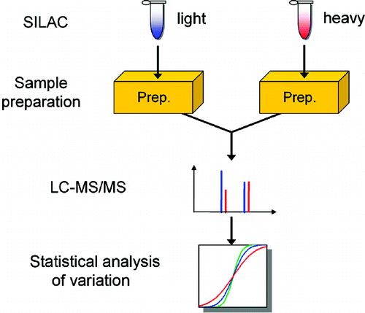
Intensity variation between runs
Replicates
1 IP
1 Fractionation
1 Digestion
vs
3 IP
3 Fractionations
1 Digestion
G. Zhang et al., JPR 8 (2008) 1285-1292

Slide 8
How significant is a measured change in amount?
It depends on the size of the random variation of the amount measurement that can be obtained by repeat measurement of identical samples.

Slide 9
Protein Complexes
A
D
A
C
B
Digestion
Mass spectrometry

Slide 10
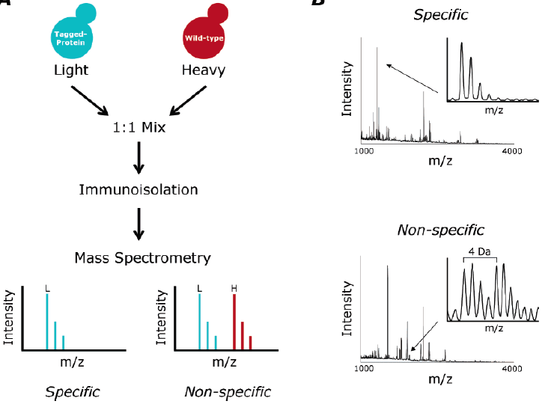
Protein Complexes – specific/non-specific binding
Tackett et al. JPR 2005

Slide 11
Protein Turnover
Heavy
Move heavy
labeled cells to
light medium
Newly produced
proteins will have
light label
Light
K_{C}=log(2)/t_{C}, t_{C} is the average time it takes for cells to go through the cell cycle, and K_{T}=log(2)/t_{T}, t_{T} is the time it takes for half the proteins to turn over.

Slide 12
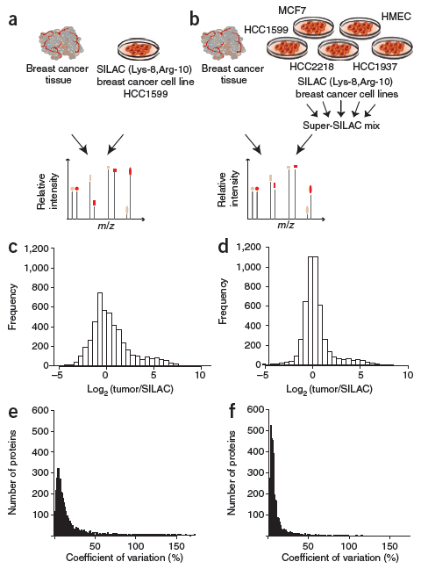
Super-SILAC
Geiger et al., Nature Methods 2010

Slide 13
Quantitation – Protein Labeling
Assumption: All losses after mixing are identical for the heavy and light isotopes and
Lysis
Light
Heavy
Fractionation
Digestion
LC-MS
MS
L
H
Gygi et al. Nature Biotech 17 (1999) 994

Slide 14
Quantitation – Labeled Proteins
Recombinant
Proteins (Heavy)
Lysis
Assumption: All losses after mixing are identical for the heavy and light isotopes and
Light
Fractionation
Digestion
LC-MS
MS
L
H

Slide 15
Quantitation – Labeled Chimeric Proteins
Recombinant
Chimeric
Proteins (Heavy)
Lysis
Fractionation
Light
Digestion
LC-MS
MS
L
H
Beynon et al. Nature Methods 2 (2005) 587
Anderson & Hunter MCP 5 (2006) 573

Slide 16
Quantitation – Peptide Labeling
Assumption: All losses after mixing are identical for the heavy and light isotopes and
Lysis
Fractionation
Digestion
Light
Heavy
LC-MS
MS
L
H
Gygi et al. Nature Biotech 17 (1999) 994
Mirgorodskaya et al. RCMS 14 (2000) 1226

Slide 17
Quantitation – Labeled Synthetic Peptides
Assumption: All losses after mixing are identical for the heavy and light isotopes and
Lysis
Fractionation
Digestion
Synthetic
Peptides
(Heavy)
Light
Enrichment with
Peptide antibody
LC-MS
Anderson, N.L., et al.
Proteomics 3 (2004) 235-44
MS
L
H
Gerber et al. PNAS 100 (2003) 6940

Slide 18
Quantitation – Label-Free (MS/MS)
Lysis
Fractionation
Digestion
LC-MS
SRM/MRM
MS/MS
MS
MS
MS/MS

Slide 19
Quantitation – Labeled Synthetic Peptides
Light
Lysis/Fractionation
Synthetic
Peptides
(Heavy)
Digestion
Synthetic
Peptides
(Heavy)
LC-MS
MS
MS
L
H
L
H
L
MS/MS
H
MS/MS
L
MS/MS
H
MS/MS

Slide 20
Quantitation – Isobaric Peptide Labeling
Lysis
Fractionation
Digestion
Light
Heavy
LC-MS
MS
MS/MS
H
Ross et al. MCP 3 (2004) 1154
L

Slide 22
Isotope distributions
Intensity
m/z
m/z
m/z

Slide 23
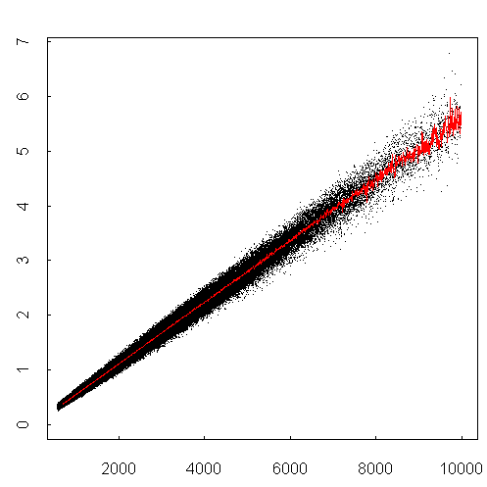
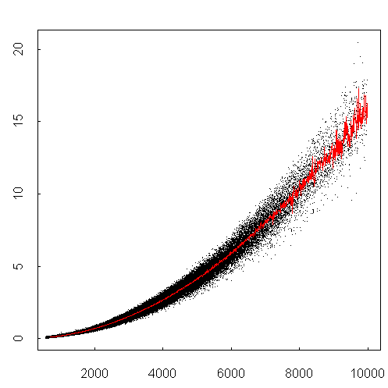
Isotope distributions
Intensity ratio
Intensity ratio
Peptide mass
Peptide mass

Slide 24
Estimating peptide quantity
Peak height
Peak height
Curve fitting
Curve fitting
Intensity
Peak area
m/z

Slide 25
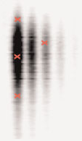
Time dimension
Intensity
m/z
Time
Time
m/z

Slide 26
Sampling
Intensity
Retention Time

Slide 27
Sampling
5%
5%
Acquisition time = 0.05σ

Slide 28
Sampling

Slide 29
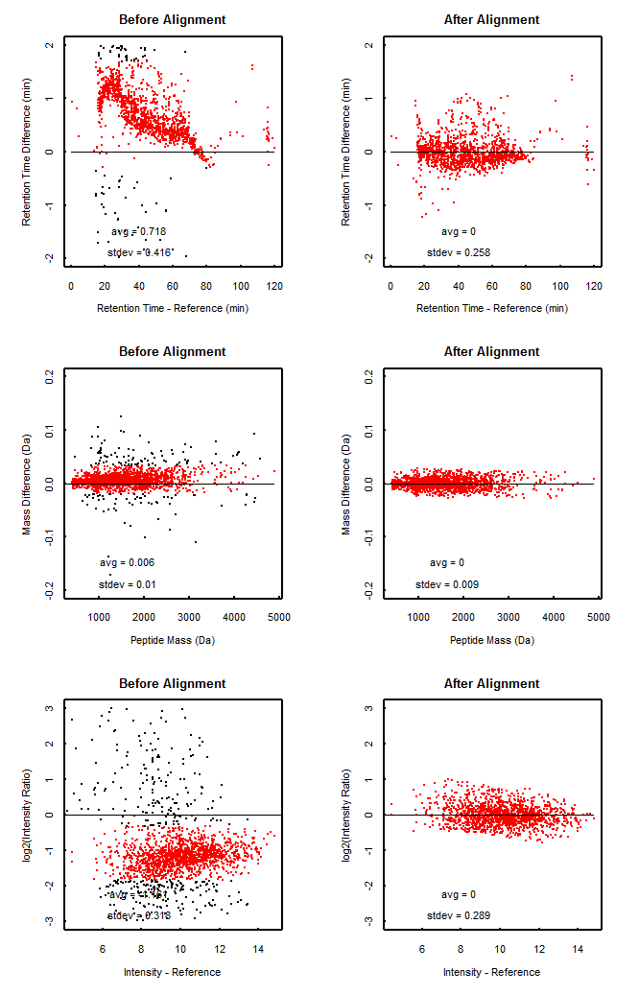
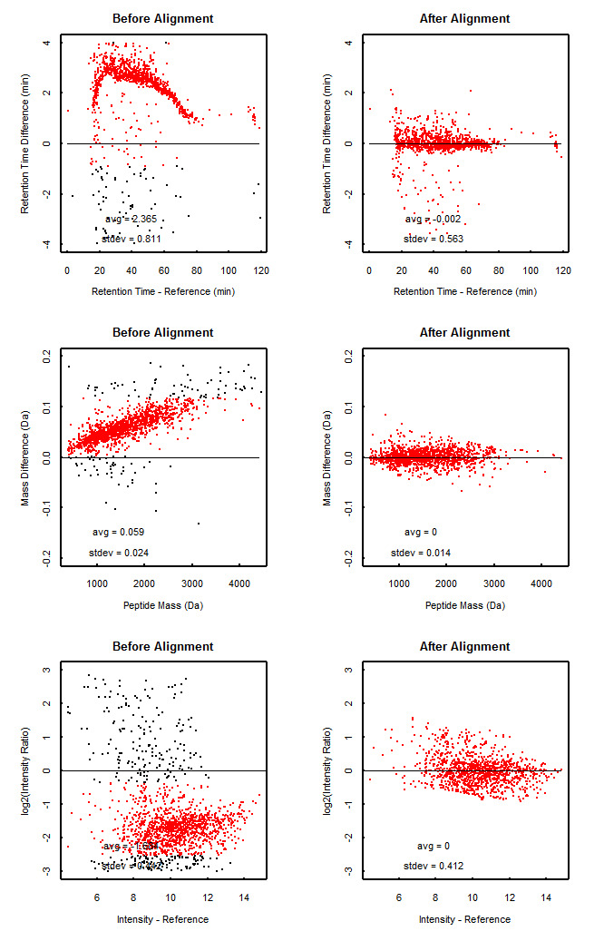
Retention Time Alignment

Slide 30
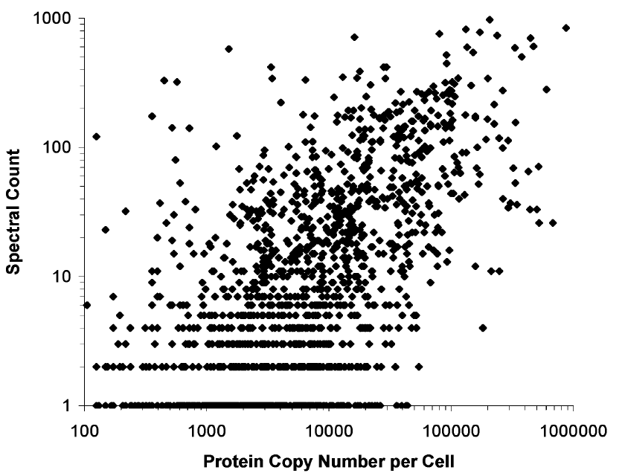
Estimating peptide quantity by spectrum counting
Time
m/z
Liu et al., Anal. Chem. 2004, 76, 4193

Slide 31
What is the best way to estimate quantity?
Peak height - resistant to interference
- poor statistics
Peak area - better statistics
- more sensitive to interference
Curve fitting - better statistics
- needs to know the peak shape
- slow
Spectrum counting - resistant to interference
- easy to implement
- poor statistics for
low-abundance proteins

Slide 32
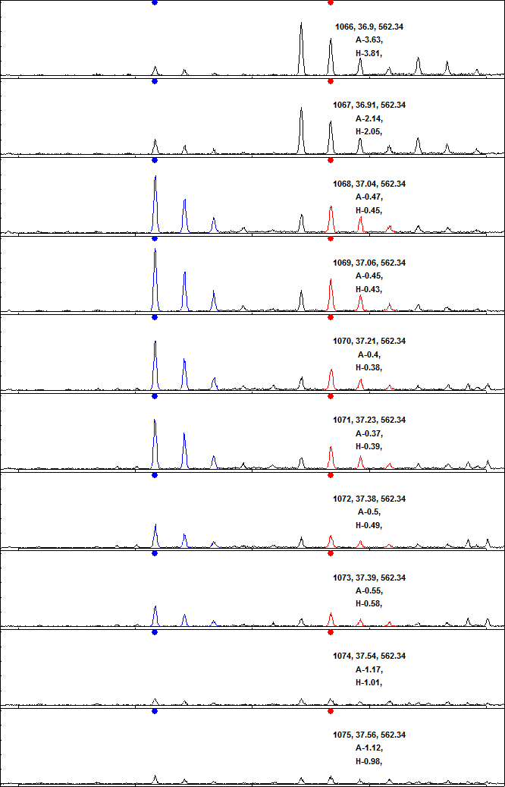
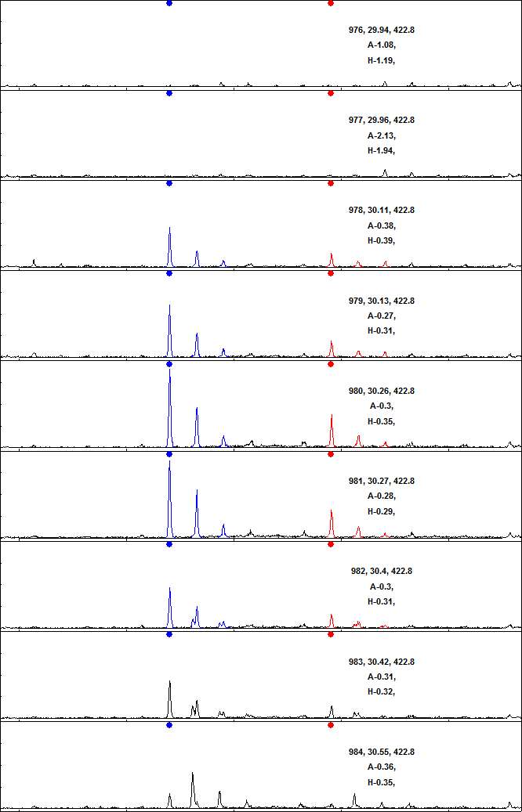
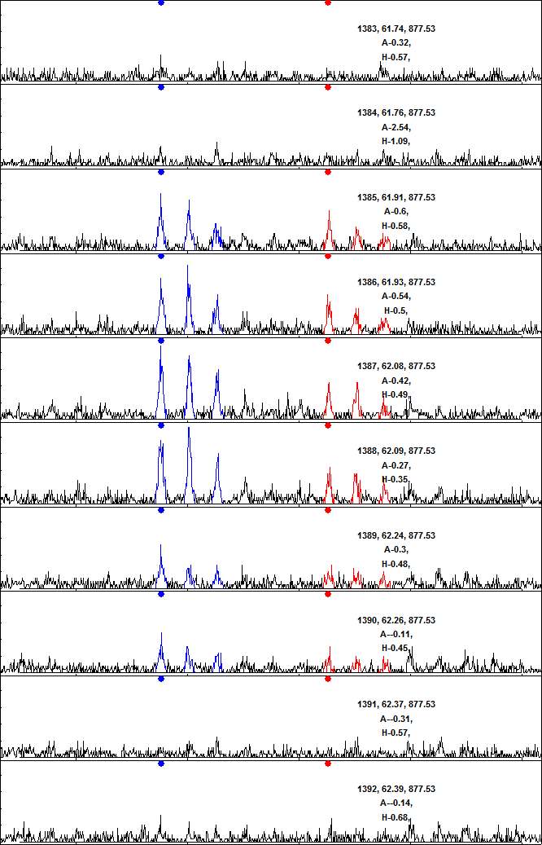
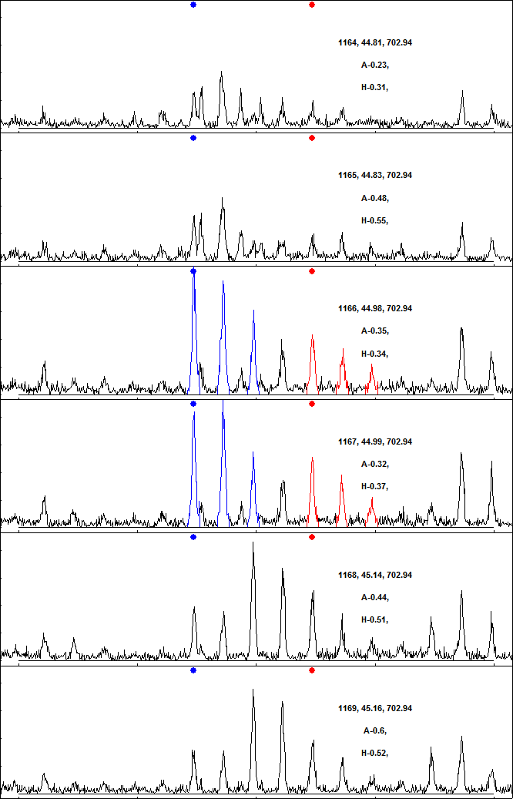
Examples - qTOF

Slide 33
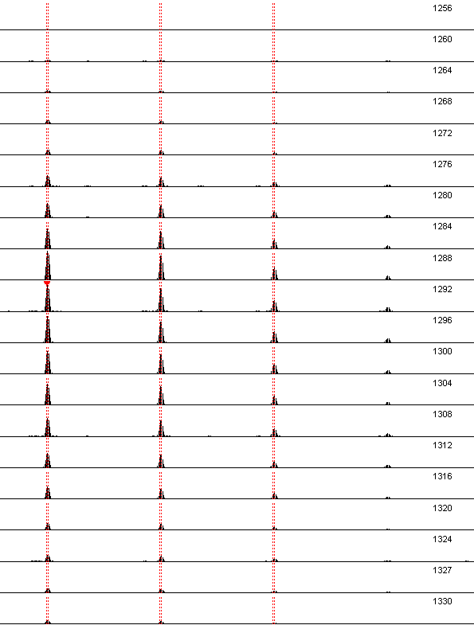
Examples - Orbitrap

Slide 34
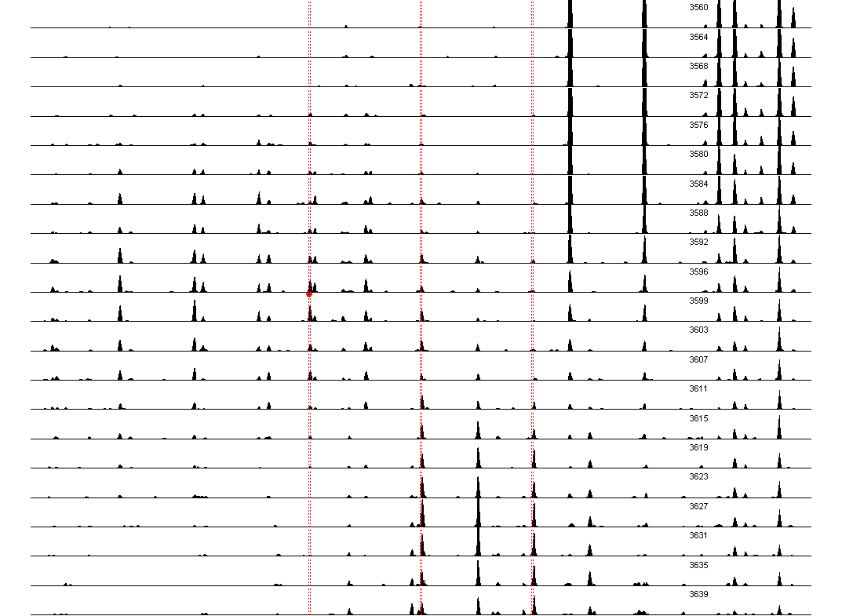
Examples - Orbitrap

Slide 35
AADDTWEPFASGK
Intensity
Intensity
Intensity
2
Ratio
1
0
2
Ratio
1
0
Time

Slide 36
AADDTWEPFASGK
Intensity
Intensity
Intensity
G
m/z
H
m/z
I
m/z

Slide 37
YVLTQPPSVSVAPGQTAR
Intensity
Intensity
Intensity
2
Ratio
1
0
2
Ratio
1
0
Time

Slide 38
YVLTQPPSVSVAPGQTAR
Intensity
Intensity
Intensity
m/z
m/z
m/z

Slide 39
Interference
Analysis of low abundance proteins is sensitive to interference from other components of the sample.
MS1 interference: other components of the sample that overlap with the isotope distribution.
MS/MS interference: other components of the sample with same precursor and fragment masses as the transitions that are monitored.

Slide 40
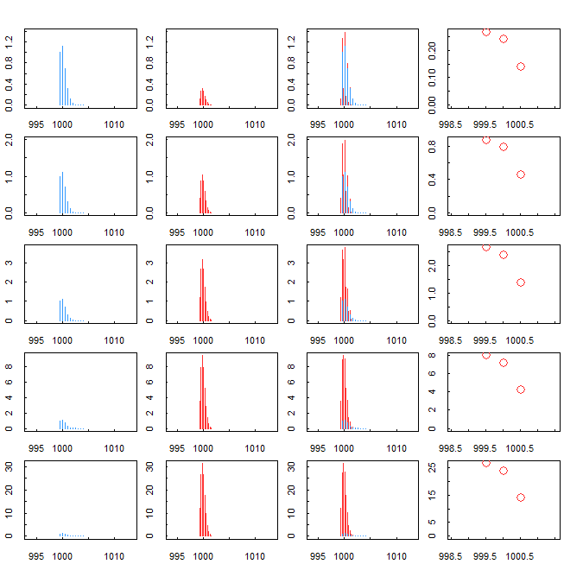
MS1 interference
Notes:
40

Slide 41
Quantitation using MRM
Peptide 1
Data taken from CPTAC Verification Work Group
Study 7.
10 peptides
3 transitions per peptide
Concentrations 1-500 fmol/μl
Human plasma background
8 laboratories
4 repeat analysis per lab
Addona et al., Nature Biotechnol. 27 (2009) 633-641
Peptide 2
Addona et al., NBT 2009

Slide 42
Quantitation using MRM
Peptide 1
Peptide 3
Peptide 2
Peptide 4
Addona et al., NBT 2009

Slide 43
Ratios of intensities of transitions
Peptide 1
Peptide 3
Peptide 1
Peptide 3
Addona et al., NBT 2009

Slide 44
Model: Noise and Interference
Can the knowledge of the relative intensity of the transitions be used to correct for interference?
Intensity
m/z
Noise is a normally distributed increase or decrease in the intensity.
Interference is an increase in the intensity of one or more transitions.

Slide 45
Detection of interference
Interference is detected by comparing the ratio of the intensity of pairs of transitions with the expected ratio and finding outliers.
Transition i has interference if
where Z_{threshold} is the interference detection threshold;
;
z_{ji} is the number of standard deviations that the ratio between the intensities of transitions j and i deviate from the noise;
I_{i} and I_{j} are the log intensities of transitions i and j;
r_{ji} is the median of the log intensity of transitions j and i;
σ_{ji} is the noise in the ratio.

Slide 46
Error in quantitation after correction
in presence of noise but no interference
Relative noise = 0.2
No interference
Relative intensity of transitions: 1:1:1

Slide 47
Corrections for interference
No Correction
0
Corrected Relative Error
Perfect Correction
0
Relative Error

Slide 48
Error in quantitation after correction
in presence of interference and noise
No correction
Correction (z_{th}=2)
Relative noise = 0.2
Interference in 1 out of 3 transitions
Relative intensity of transitions: 1:1:1

Slide 49
Error in quantitation after correction
in presence of interference and noise
Relative error before correction 0.3-0.7
z_{treshold} = 0
z_{treshold} = 1
z_{treshold} = 2
z_{treshold} = 3
Relative error before correction 1.3-1.7
Relative noise = 0.2
Interference in 1 out of 3 transitions
Relative intensity of transitions: 1:1:1

Slide 50
Error in quantitation after correction
in presence of interference and noise
Interference in
1 out of 3 transitions
Interference in
2 out of 3 transitions
z_{th} = 2
Relative noise = 0.2
Relative intensity of transitions: 1:1:1

Slide 51
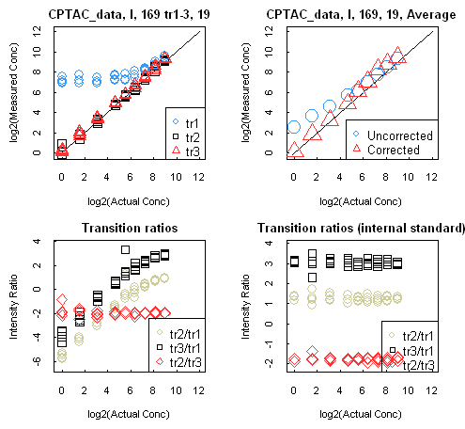
Correction for MS2 interference
Notes:
51

Slide 52
Workflow for quantitation with LC-MS
Standardization
Retention time alignment
Mass calibration
Intensity normalization
Quality Control
Detection of problems with
samples and analysis
Quantitation
Peak detection
Background subtraction
Limits for integration in time and mass
Exclusion of interfering peaks

Slide 53
Takeaway Message
There are many different ways to quantitate proteins – choose the one that is appropriate for your application.
In general the earlier you can introduce isotopic labels the better the accuracy.
Always monitor for interference.

Slide 54
Protein quantitation I: Overview (Week 6)

